Slide 1

Team name : InTouch
Project Title : Intelligent Post-Lock Down Management System for Public Transportation
Project ID : SPS_PRO_720
Team Leader : Barnini Goswami
Team Members: Barnini Goswami, Kajal Gupta, Shreya Majumdar
IBM HACK CHALLENGE 2020

Slide 2

COVID-19 TRAVEL COVER

Slide 3
ABSTRACT
People are not safe enough to move freely in the country due to the covid-19.
The COVID 19 pandemic has grown out to be extremely contagious because of which it became risky to allow the public transportation without proper mechanism to maintain social distancing.
So, to resolve this problem we came up with an idea of making an intelligent application to schedule the timings of transportation, avoiding over occupancy of public transport, providing them the shortest route to reach their desired destination, providing them proper guidelines .
We have divided the regions according to PINCODES or ZIPCODES. Our algorithm will find the shortest possible route from source to destination and seats will be booked following the social distancing.

Slide 4
PROPOSED SOLUTION
The main idea is to design an App which will smartly manage the social distancing and decide the route of the transport based on crowding and shortest route.
The App will ask to sign up, that means registration will take place for all passengers and after signing up, an authentication page will be launched, which will ask for ID proof of the customer, so that our app could be used in the desired way.
In order to make the booking task less burdensome the customer has to enter his home address details in Address Page and then “usual” destination details in Destination Page.
Ticket booking page would be launched to book the tickets and it would show the available timings and seats observing the social distancing method.
The app would contain a page of Guidelines for Covid-19 and the booking tickets option will be provided through the guidelines page to ensure that the users are aware of the basic safety measures before booking the tickets.

Slide 5
PROPOSED SOLUTION
This app also has a mask detection system by which it will detect whether an individual has worn a mask or not, this will help in ensuring the safety.
The app will let know the routes from source to destination in ascending order which will lead to decrease in traffic congestion and the number of seats have been reduced to maintain social distancing inside the bus as well as on roads.
We will also ask the user to enter the purpose before booking the ticket so that data can be maintained regarding healthcare related purposes for future use.
The timetable is dynamic in such a way that any changes made in the database will automatically be reflected on the web page.
Users not wearing masks will not be allowed to travel as validation of ticket is based on mask detection system

Slide 6

Technology stack
Backend (Atom / Visual studio code)
Java
Python
MySql
Frontend (UI/UX)
HTML
CSS
JAVASCRIPT
BOOTSTRAP.

Slide 7
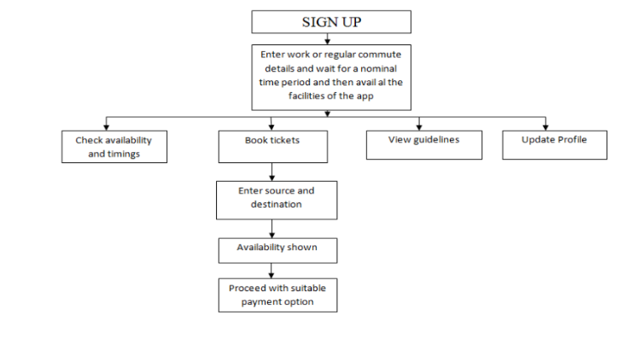
ARCHITECTURAL FLOW
(1) Block Diagram

Slide 8
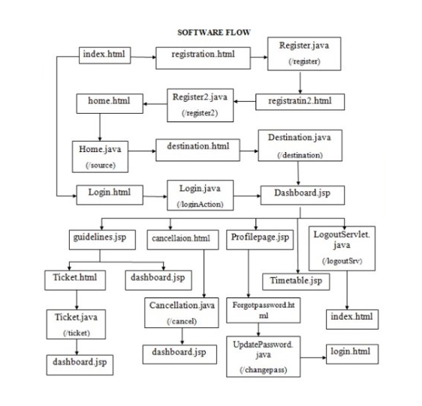
(2) SOFTWARE DESIGNING

Slide 9
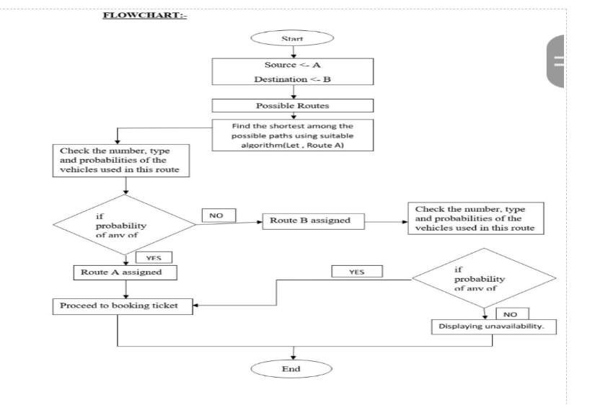
(3)FLOWCHART SHORTEST PATH ALGORITHM

Slide 10
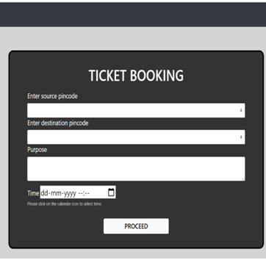
Result
(1) TICKET-BOOKING

Slide 11
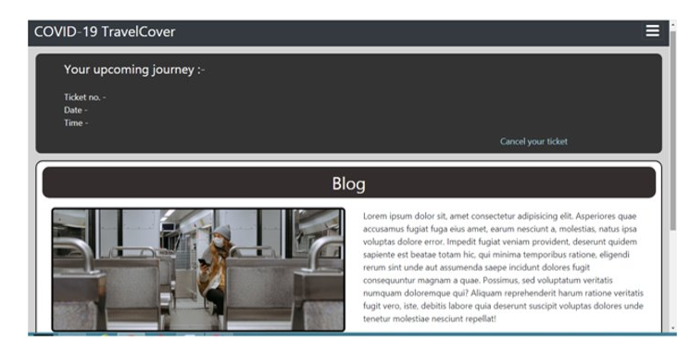
(2) DASHBOARD

Slide 12
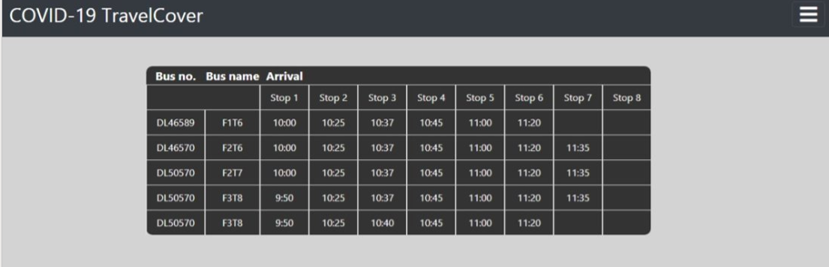
(3)TIMETABLE
The time table is dynamic whenever the timings will be updated in the database it will get updated here in the user interface also

Slide 13
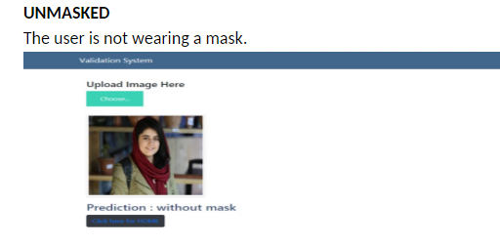
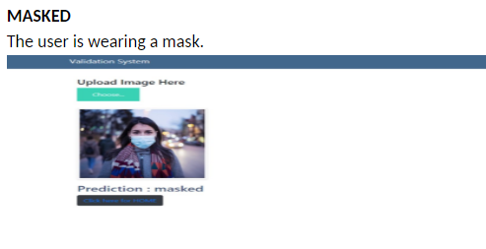
(4) MASK DETECTION SYSTEM

Slide 14
FUTURE SCOPE
This app would allow seamless functioning of public transportation even in these worst conditions to help stabilize the economy again.
Although we have tried to implement all the features that we had planned but scope of improvement is always there.
In mask detection system instead of asking the user to upload a photo we can implement this feature over webcam or front camera in case of mobiles., so that there will be no possibility of uploading an unsuitable picture.
We can implement a penalty system which would include imposing penalties on users who would violate the guidelines mentioned in our application.

Slide 15
CONCLUSION
Now we desperately need a dependable solution to tackle the growth of infections of COVID-19 and that would facilitate proper public transportation management post lockdown.
To ensure everyone’s wellbeing and safety we are introducing an intelligent post lockdown management system for public transport which will help in avoiding over occupancy of public transport and will help people to maintain social distancing which will lower their risk of getting infected by COVID-19.
In our application, we will keep a track of purpose of each passengers travel and maintain a record for healthcare officials using our application for analysis and future prospects.
Through our ticket booking system we will try to reduce the transit time for users as much as possible thus saving time and comparatively reducing the risk of the individual getting infected.
All the money transactions would be done through e-currency thus reducing the chances of infection being spread through physical currency.

Slide 16
Thank You ! Stay healthy and safe.

